Slide 1

CX Journey Management Overview
2020 Fall WTWY Annual Gala : Proposal for Engaging prospective audience

Slide 2




PROJECT TEAM
Andrew
Role A
Ganesh
Role B
Navish
Role C
Zach
Role D
2019 WomenTechWomenYes (WTWY) Annual Gala, NYC

Slide 3
AGENDA
Executive Summary : Insights, Recommendation & Opportunity
Key Considerations: Analysis Scope, Data & Assumptions
Macro-View of the New York MTA service areas
Snapshot #1 + commentary
Snapshot # 2 + commentary
Snapshot #3 & commentary
Wrap-up (bring it home!) ** Next steps & reco **
2019 WomenTechWomenYes (WTWY) Annual Gala, NYC

Slide 4



EXECUTIVE SUMMARY
INSIGHT
xxx
yyy
zzz
RECOMMENDATION
Reco1
Reco2
OPPORTUNITY
We see a real opportunity to increase awareness/reach among the target audience of technology professionals and drive sign-ups for the upcoming annual gala by strategically deploying smaller teams to 10 stations in the city to reach over 60% of the targets
2019 WomenTechWomenYes (WTWY) Annual Gala, NYC

Slide 5
SCOPE, DATA & ASSUMPTIONS
SCOPE
DATA SOURCES
ASSUMPTIONS
Develop an optimized recommendation for WTWY International to help drive awareness and increase sign-ups for upcoming Fall 2020 WTWY Gala
Gather insights on average daily commuter traffic on the MTA network
Identify a small group of stations that drive a significant share of traffic (MTA Hot Spots)
Recommend an approach to maximize outcomes in the lead-up to the Fall 2020 Gala
Jointly collaborate and align on action plan and expectations around outcomes
Discuss and document learnings that can be leveraged for future efforts
MTA Turnstile Data
Geo Location Data (for stations within the MTA network)
The Fall 2020 Gala is assumed to be an online event
To maximize our ability to reach the target audience (tech enthusiasts), we limited our analysis to focus on key work-related commute hours.
Based on high density commuter traffic and geographic proximity, the analysis was limited to Manhattan borough
KEY CONSIDERATIONS
¹ Source: http://web.mta.info/developers/turnstile.html (MTA Turnstile Data)
² Source: http://web.mta.info/developers/turnstile.html
2019 WomenTechWomenYes (WTWY) Annual Gala, NYC

Slide 6
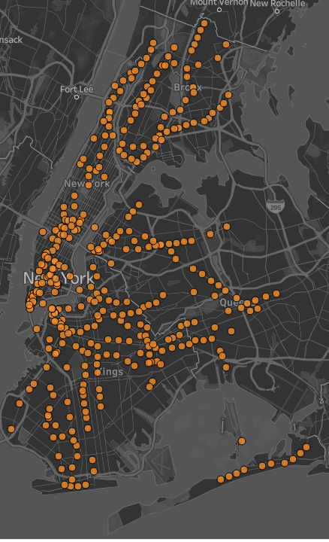
New York City MTA : Key Stats
2.3M+
Riders served on average each day
Includes daily commuters and visitors to NYC
379
Stations
Oldest and largest public transportation system in the world (in terms of number of stations)
4
Serves the 4 boroughs
The New York subway system operates in Manhattan, Queens, Brooklyn, and the Bronx. It never leaves New York City.
x
Xyyyyy
A mlk;lsvdlkjv; sklj;lksfej
2019 WomenTechWomenYes (WTWY) Annual Gala, NYC

Slide 7
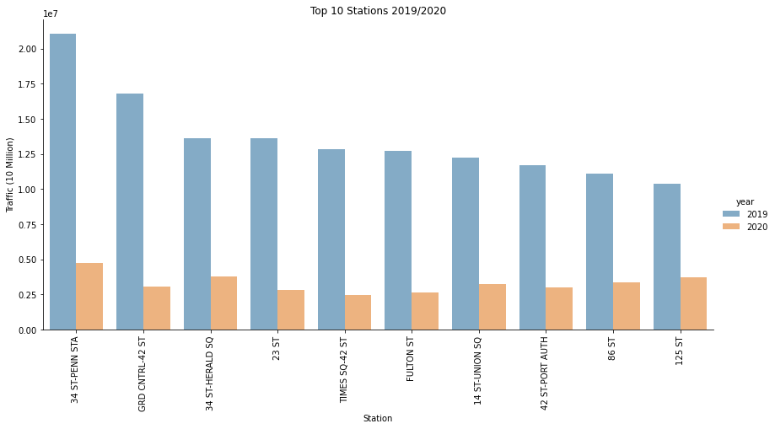
No significant change to rankings of stations based on commuter traffic between 2019 and 2020
Less total traffic, relative to 2019, due to the current Pandemic
The top rankings remain relatively unaffected – as a result, we have high confidence in using 2020 data
Top Ranked MTA Stations ( By Commuter Traffic)
Penn Station
Grand Central
xx
2019 WomenTechWomenYes (WTWY) Annual Gala, NYC

Slide 8
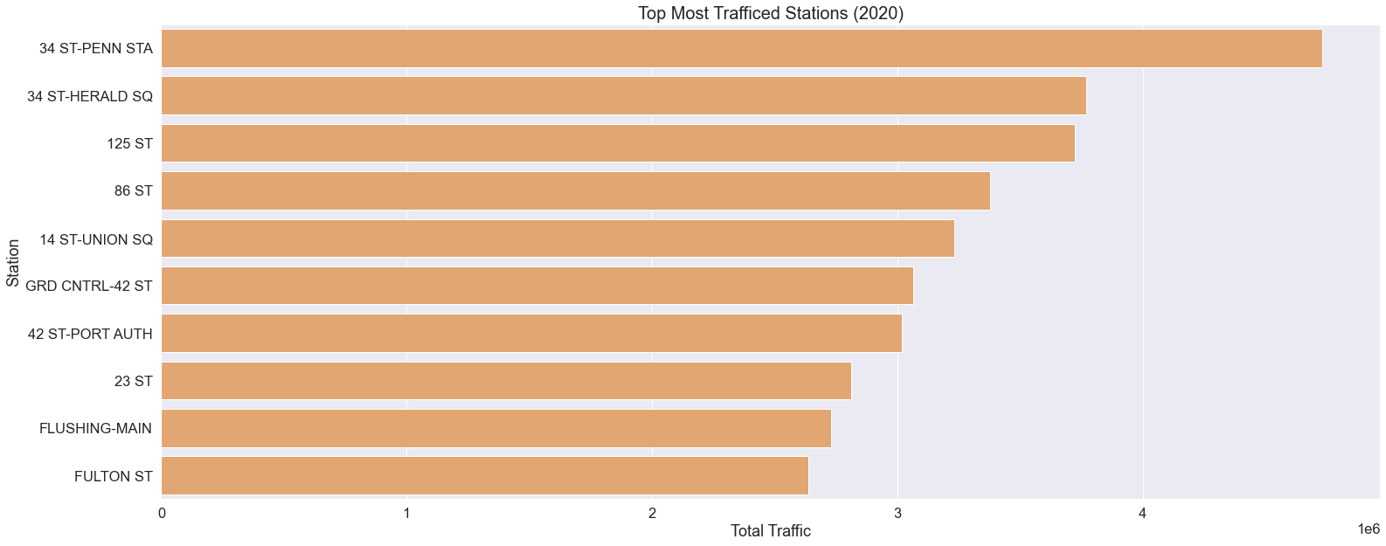
2020 Top 10 Stations with the most commuter traffic
On average, 17% of the MTA commuter traffic pass thru the top 10 stations ( 2% of stations)
2019 WomenTechWomenYes (WTWY) Annual Gala, NYC

Slide 9
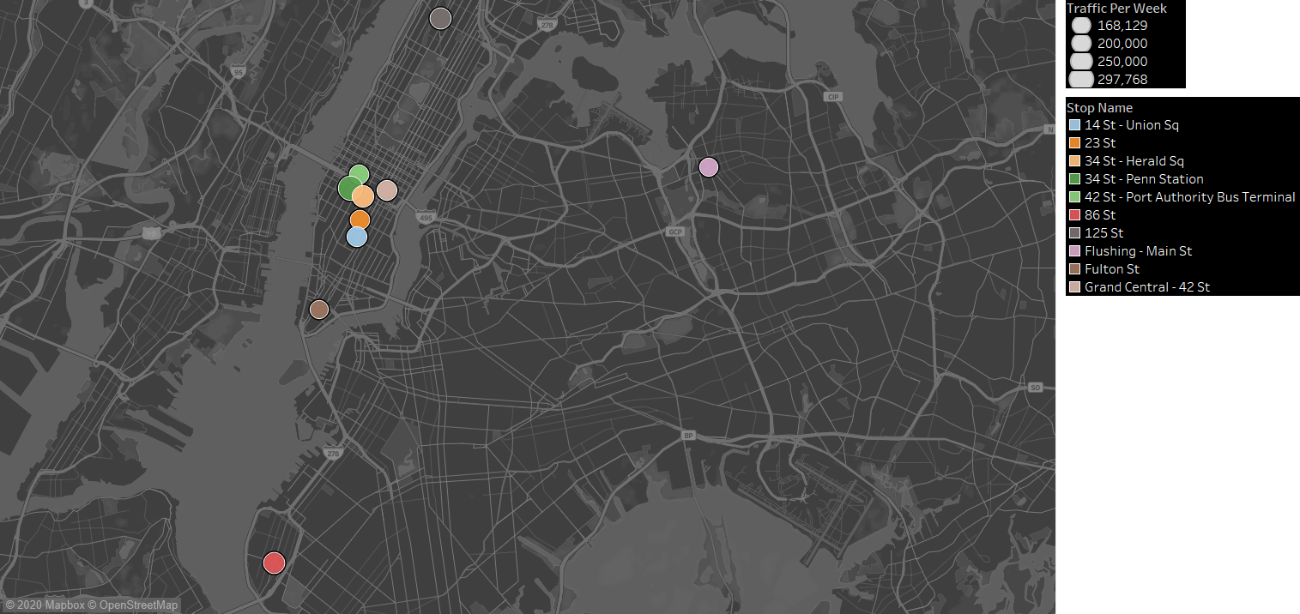
An aerial view of stations with high density commuter traffic shows logical clusters
Majority of the Hot-Spot stations are clustered around Manhattan, below Central Park
The remaining few Hot-Spot stations are spread across the other 3 boroughs
2019 WomenTechWomenYes (WTWY) Annual Gala, NYC
Notes:
Talking pts.:
-Some of them are clustered around transfer stations
- Our recommendations are based of our analysis of the Manhattan

Slide 10
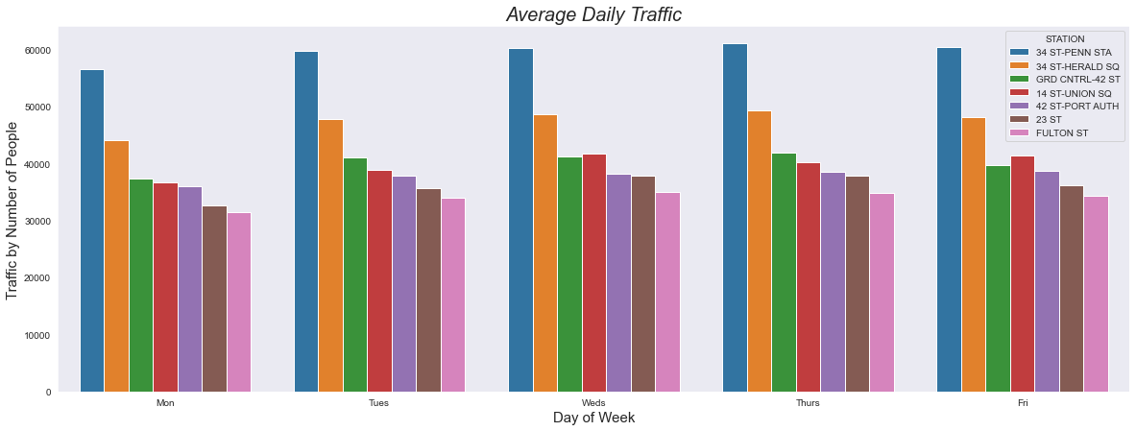
Daily traffic patterns at ‘Hot Spot’ MTA stations
Analysis focused on weekday commuter traffic
2019 WomenTechWomenYes (WTWY) Annual Gala, NYC
Notes:
What percentage of traffic goes thru these 7 stations? What is the targetable audience based on some assumptions on traffic patterns during weekdays?

Slide 11
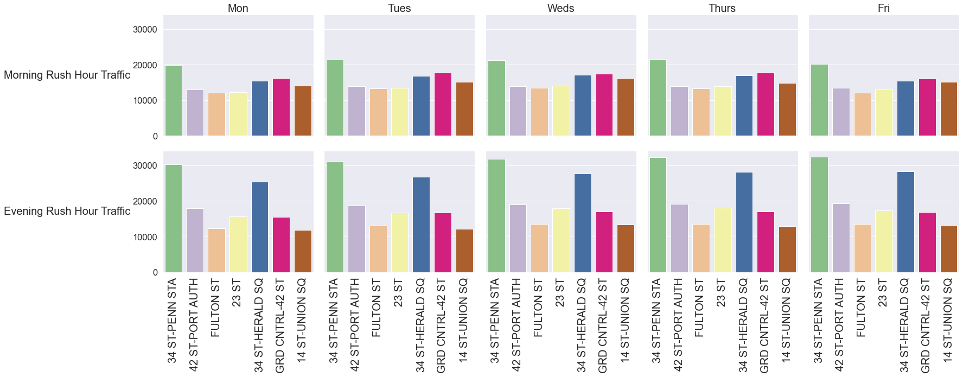
Not all times of the day are alike…
2019 WomenTechWomenYes (WTWY) Annual Gala, NYC
Notes:
What percentage of traffic goes thru these 7 stations? What is the targetable audience based on some assumptions on traffic patterns during weekdays?

Slide 12
Recommendation & Opportunities for the future
Where
Top 3- 5 listed below
yyy
zzz
When
Day of week
Time of day
What/How?
We see a real opportunity to increase awareness/reach among the target audience of technology professionals and drive sign-ups for the upcoming annual gala by strategically deploying smaller teams to 10 stations in the city to reach over 60% of the targets
Insert Map here
2019 WomenTechWomenYes (WTWY) Annual Gala, NYC
Notes:
Email Referrals/ Advocacy
Media Placements partnering with other companies that support the cause
Social Engagement to keep the buzz around future events

Slide 13
Appendix
2019 WomenTechWomenYes (WTWY) Annual Gala, NYC

